Slide 1
Convection Diffusion Code in OpenFoam

Slide 2
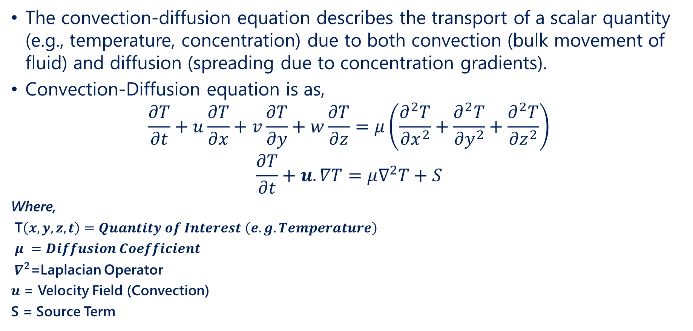
Convection-Diffusion Equation
The convection-diffusion equation describes the transport of a scalar quantity (e.g., temperature, concentration) due to both convection (bulk movement of fluid) and diffusion (spreading due to concentration gradients).
Convection-Diffusion equation is as,
$$\frac{∂T}{∂t}+u\frac{∂T}{∂x}+v\frac{∂T}{∂y}+w\frac{∂T}{∂z}=μ\left(\frac{∂^{2}T}{{∂x}^{2}}+\frac{∂^{2}T}{{∂y}^{2}}+\frac{∂^{2}T}{{∂z}^{2}}\right)$$
$$\frac{∂T}{∂t}+u.∇T=μ∇^{2}T+S$$
Where,
T$\left(x,y,z,t\right)=Quantity of Interest$ $\left(e.g. Temperature\right)$
$μ =Diffusion Coefficient$
${ ∇}^{2}$=Laplacian Operator
$u$ = Velocity Field (Convection)
S = Source Term

Slide 3
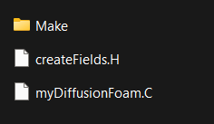
Code Development in OpenFOAM
OpenFOAM (Open Field Operation and Manipulation) is an open-source CFD toolkit designed for a wide range of applications, including fluid dynamics, heat transfer, and chemical reactions.
It provides a comprehensive suite of solvers, utilities, and libraries, enabling users to model complex physical processes.
OpenFOAM's architecture is modular and object-oriented, facilitating the development of custom solvers and utilities.
This design allows users to extend existing functionalities or create new ones by leveraging a vast library of pre-defined classes and functions.
The implementation of solvers and utilities typically involves writing C++ source files (.C) and header files (.H). These files define the core functionality and interface of the components being developed.

Slide 4
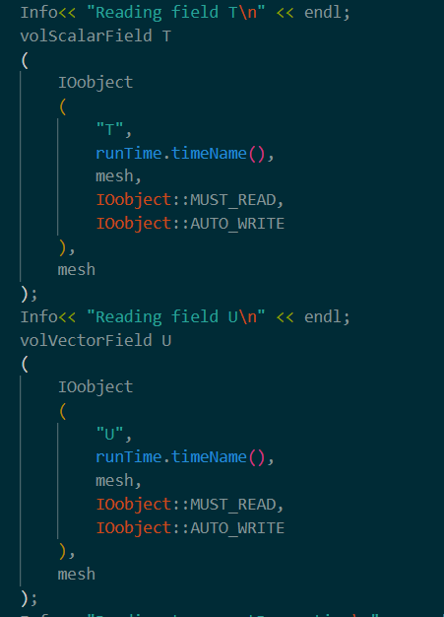
Header File
The temperature field is read using the volScalarField class.
They contain declarations of classes, functions, templates, and variables, making these components accessible to other parts of the code.
Header files define the public interface of classes, including member functions and data members, allowing other code to interact with these classes.
These prevent multiple inclusions of the same header file, which could lead to compilation errors.
IOobject reads field T, with MUST_READ ensuring it's required and AUTO_WRITE saving the data automatically.
The velocity field is read using the volVectorField class.

Slide 5
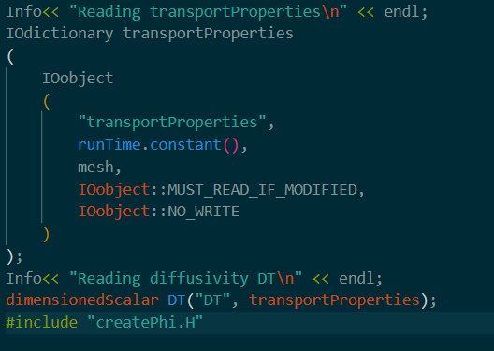
Header File
The transport properties dictionary is loaded from the case directory.
transportProperties reads parameters like diffusivity, with MUST_READ_IF_MODIFIED only reading changes and NO_WRITE preventing automatic saving.
dimensionedScalar reads the diffusivity scalar with its units, while dimViscosity defines the dimension for diffusivity.

Slide 6
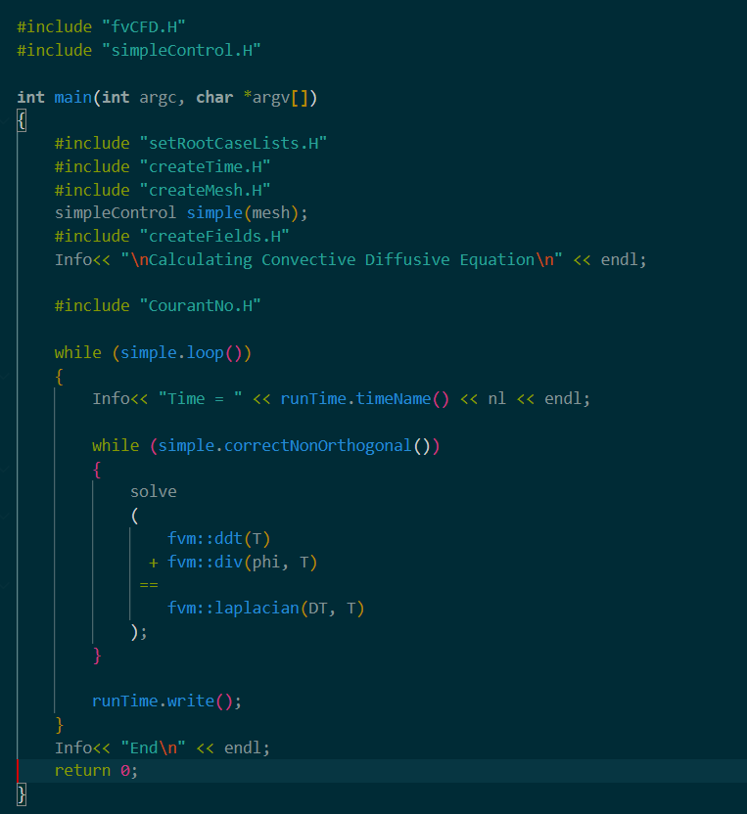
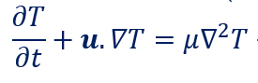
Source File
Source file includes its corresponding header and other necessary headers, such as fvCFD.H and fvm.H, which provide functions for discretization and solving.
The constructor initializes the field and coefficient. The destructor is defined but may be empty if no specific cleanup is required.
This file implements the core logic for solving the diffusion equation. It constructs a finite volume matrix equation representing the discretized form of the PDE and calls equation.solve() to compute the solution.

Slide 7
Source Code Explanation
fvCFD.H includes finite volume methods, while simpleControl.H manages simple time-stepping loops.
Creates and initializes field variables, such as temperature (T) and velocity (phi), used in the simulation.
setRootCaseLists.H sets up case directories, createTime.H initializes simulation time, and createMesh.H generates the computational mesh.
simpleControl manages time-stepping and convergence checks, linking to the mesh for simulation progression.
simple.loop() iterates through each time step, while solve() computes the convective-diffusive equation using fvm::ddt(T) for the time derivative, fvm::div(phi, T) for convection, and fvm::laplacian(DT, T) for diffusion.
Saves simulation results at each time step and indicates the completion of the simulation.

Slide 8
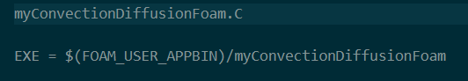
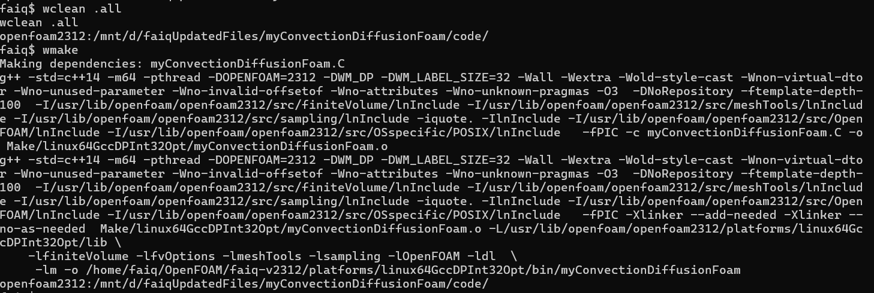
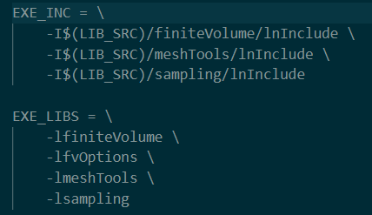
Integration and Compilation
OpenFOAM uses a wmake build system to compile C++ files. The Make directory typically contains files and options files that specify the source files to compile and the libraries to link against.
Compiling make directory to make sure solver works without any error.
Files
Options

Slide 9
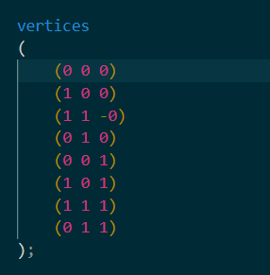
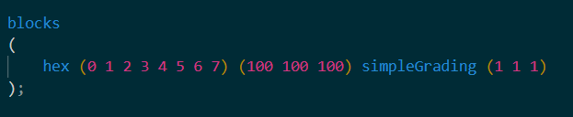
Mesh Configuration with blockMeshDict
Vertices:
Defines the coordinates of all vertices in the mesh.
Each vertex is specified as a vector of three components (x, y, z).
Blocks:
Defines the hexahedral blocks that make up the mesh.
Each block is defined by listing the vertices in a specific order, followed by the number of cells in each direction (x, y, z).
The grading parameter specifies how the cells are distributed within the block.

Slide 10
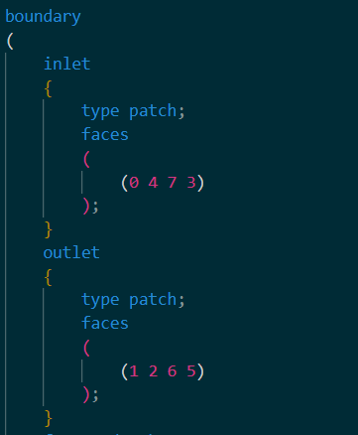
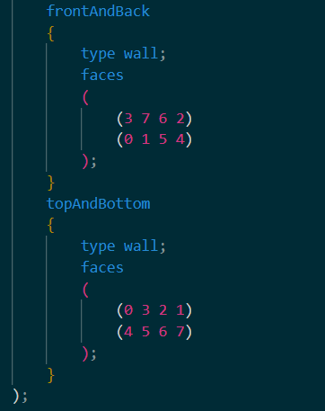
Mesh Configuration with blockMeshDict
Boundary:
Defines the boundary patches of the mesh, which correspond to the physical boundaries of the simulation.
Each boundary is given a name, type, and lists of the faces that belong to it.

Slide 11
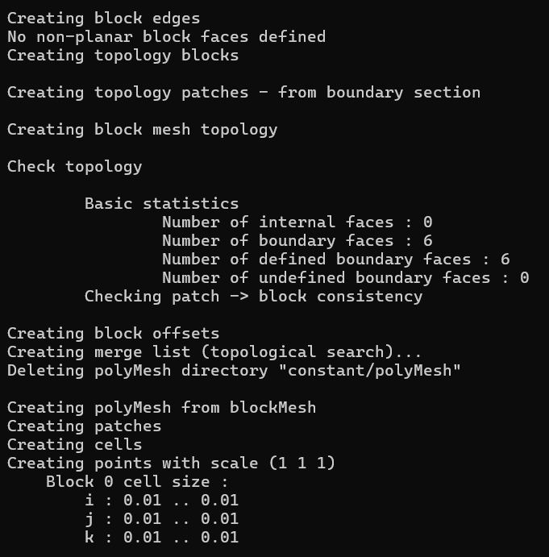
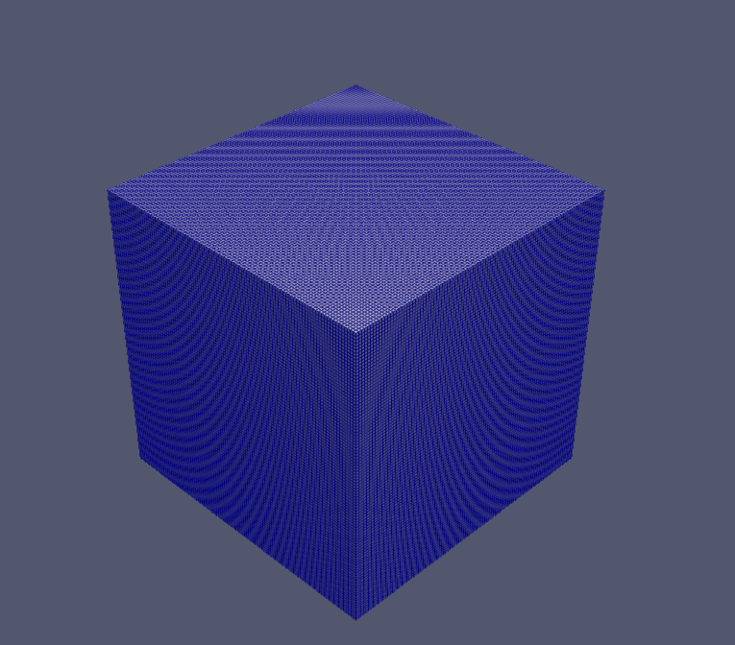
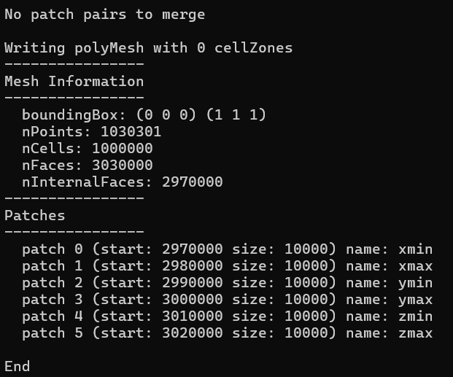
Creating Mesh
blockMesh

Slide 12
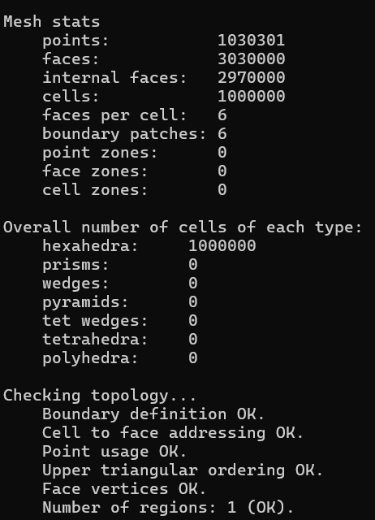
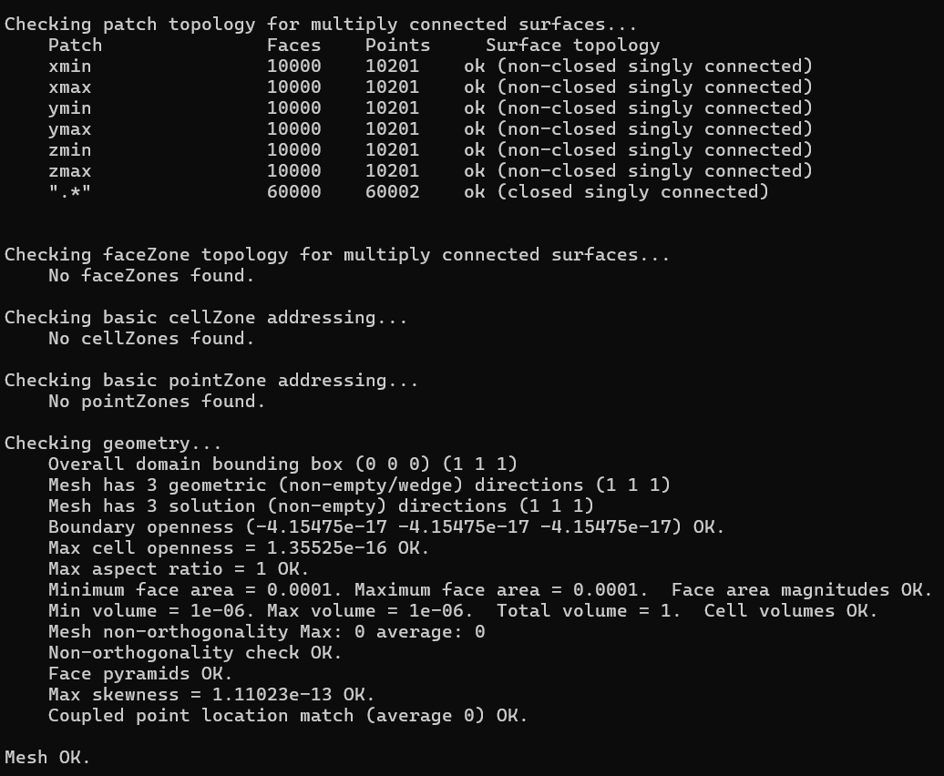
Running Simulation
The boundary definition is correct, and checks for cell-to-face addressing, point usage, and face vertices all passed without issues. The mesh contains 1 continuous region with no disconnected parts.
Ideal for structured grids
checkMesh
The mesh spans a bounding box from (0 0 0) to (1 1 1) with a maximum aspect ratio of 1, indicating no distortion. Face areas and cell volumes are uniform, with values of 0.0001 and 1e-06
The non-orthogonality is ideal with values of 0, skewness is very low at 1.11e-13, boundary openness is near zero which are required for perfect mesh.

Slide 13
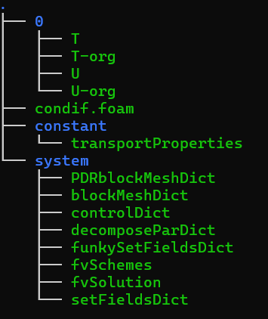
Test Case Setup
Setting up a simulation involves organizing and configuring files across several directories: system, constant, and 0. Each directory serves a specific purpose in defining the simulation environment, physical properties, and initial conditions
0 Directory:
The 0 directory is the initial time directory, where initial conditions for the simulation are specified.
Include boundary conditions and internal field values.

Slide 14
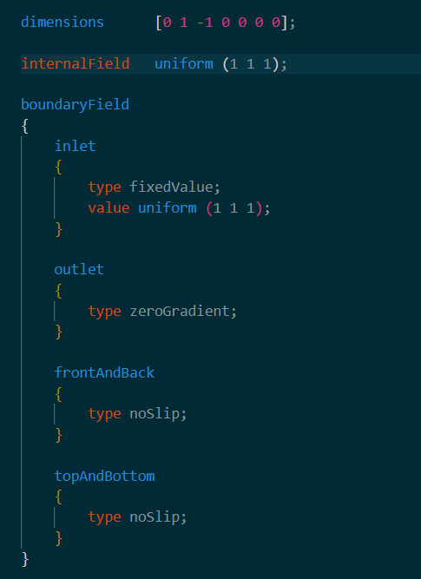
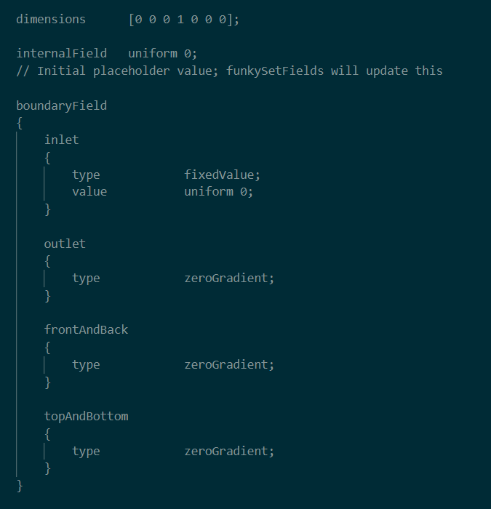
0 Directory
U file
T file

Slide 15
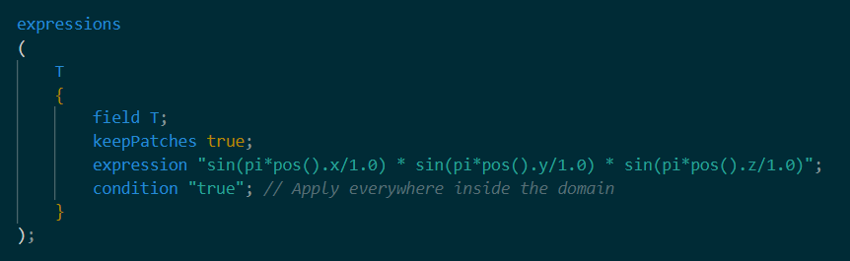
Boundary Conditions using Swak4Foam
Swak4Foam:
swak4Foam is primarily used for defining boundary and initial conditions in OpenFOAM simulations. It provides a flexible and powerful way to specify conditions through a scripting interface, allowing users to easily implement complex boundary and initial conditions in their simulations.
Defines a list of expressions for setting fields.
Retains the patch values, ensuring boundary conditions are preserved.
Specifies that this expression will set the values for the field T.
This condition applies the expression everywhere within the domain, meaning the sinusoidal function will set the temperature throughout the entire volume.
The mathematical expression for the field sets the temperature T based on a sinusoidal function dependent on the spatial coordinates (x,y,z).

Slide 16
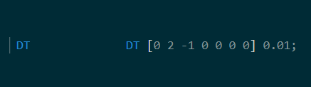
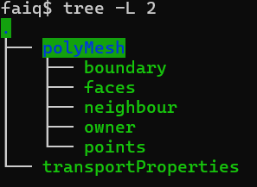
Constant Directory
The constant directory holds files that describe the physical properties of the simulation and the mesh configuration.
Transport Properties:
Defines physical properties such as the diffusion coefficient.
Critical for specifying how materials behave during the simulation.
PolyMesh
Contains mesh files like blockMeshDict used to define the geometry and mesh structure.
Specifies the mesh type, resolution, and boundaries.

Slide 17
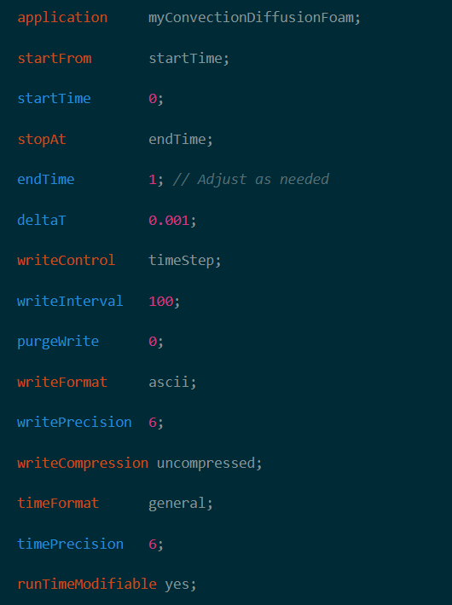
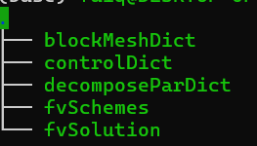
System Directory
The system directory contains files that control the overall simulation setup, including time-stepping, numerical schemes, and solver settings.
Control Dict:
Manages the simulation's start and end times, time step size, and data output frequency.

Slide 18
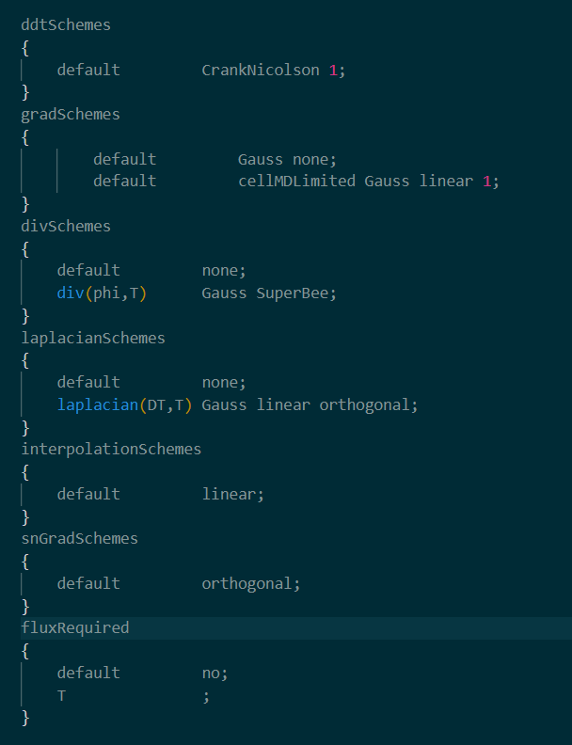
FvSchemes
Specifies the numerical schemes for discretizing differential equations.
Controls the accuracy and stability of the solution.
ddtSchemes
CrankNicolson 1: A time discretization scheme that blends implicit and explicit methods (Crank-Nicolson) with a weighting factor of 1 (fully implicit). It provides second-order accuracy in time and stability for transient simulations.
gradSchemes
Gauss none: No gradient scheme specified, but a more detailed gradient scheme is defined below.
cellMDLimited Gauss linear 1: A second-order gradient scheme using cell-based limited differencing (to prevent oscillations), suitable for capturing smooth gradients while avoiding unphysical results near discontinuities.

Slide 19
FvSchemes
divSchemes
div(phi,T) Gauss SuperBee: The SuperBee limiter is a high-resolution scheme for flux calculation. It reduces numerical diffusion while maintaining stability in capturing sharp gradients.
laplacianSchemes
laplacian(DT,T) Gauss linear orthogonal: This uses the Gauss theorem to compute laplacians with linear interpolation, assuming orthogonal mesh cells. It provides accurate diffusion terms in problems where the mesh is mostly aligned with the physical domain.
interpolationSchemes
linear: A basic second-order linear interpolation scheme, suitable for cases where smooth variations between cell values are expected.
snGradSchemes
Orthogonal: The orthogonal gradient scheme assumes that cell faces are perfectly perpendicular to the direction of gradient calculation, which simplifies and improves gradient accuracy when the mesh is orthogonal.

Slide 20
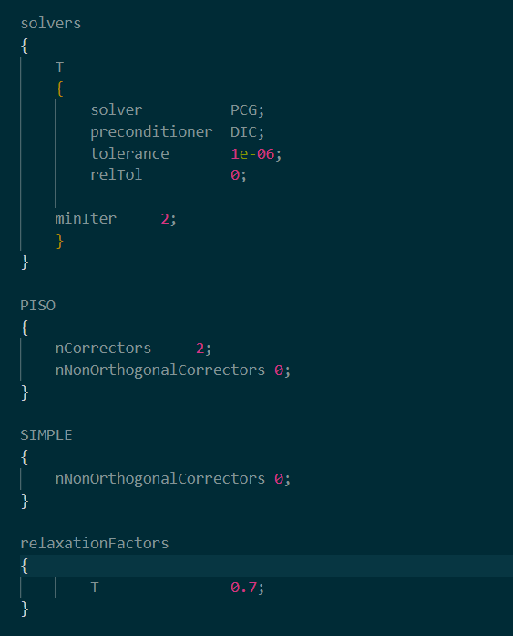
FvSolution
Contains solver settings and tolerance criteria for iterative solvers.
Defines how equations are solved during the simulation.
solvers: Uses PCG (Preconditioned Conjugate Gradient) for solving the temperature field with DIC (Diagonal Incomplete Cholesky) as a preconditioner for improved convergence.
PISOnCorrectors: Performs 2 corrector steps to enhance accuracy in transient simulations with no additional corrections for non-orthogonal meshes
SIMPLEnNonOrthogonalCorrectors: No non-orthogonal corrections applied, simplifying the solver approach.
relaxationFactors: Sets a relaxation factor for temperature to stabilize iterations and enhance convergence.

Slide 21
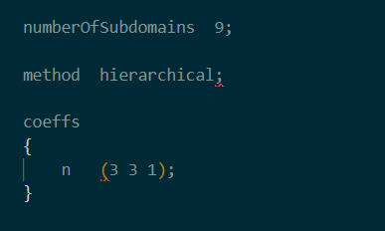
decompasePar
numberOfSubdomains: Specifies that the computational domain will be divided into 9 subdomains, allowing for parallel processing to improve computational efficiency and reduce simulation time.
method hierarchical: Indicates the use of a hierarchical method for domain decomposition. This method organizes subdomains in a hierarchical structure, optimizing the load balance and communication between processors.
coeffsn (3 3 1): Defines the decomposition coefficients. In this case, the domain is split into 3 subdomains in the x-direction, 3 in the y-direction, and 1 in the z-direction, effectively partitioning the computational space for parallel execution.

Slide 22
Running Simulation
Simulation can be run using following command,
myConvectionDiffusionFoam >log.simulation
To run in parallel,
mpirun -np "$NUM_PROCESSORS" myConvectionDiffusionFoam > log.simulation
log.simulation saves all the data in log file to go through it later.
Bash file can also be run directly for ease of use, by using it all the commands will run automatically,
./runex2.sh

Slide 23
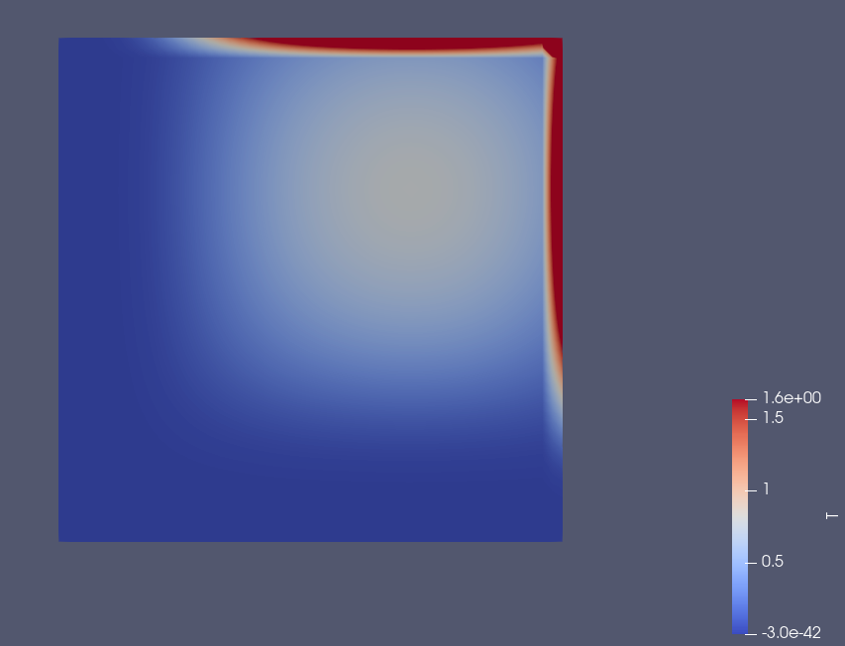
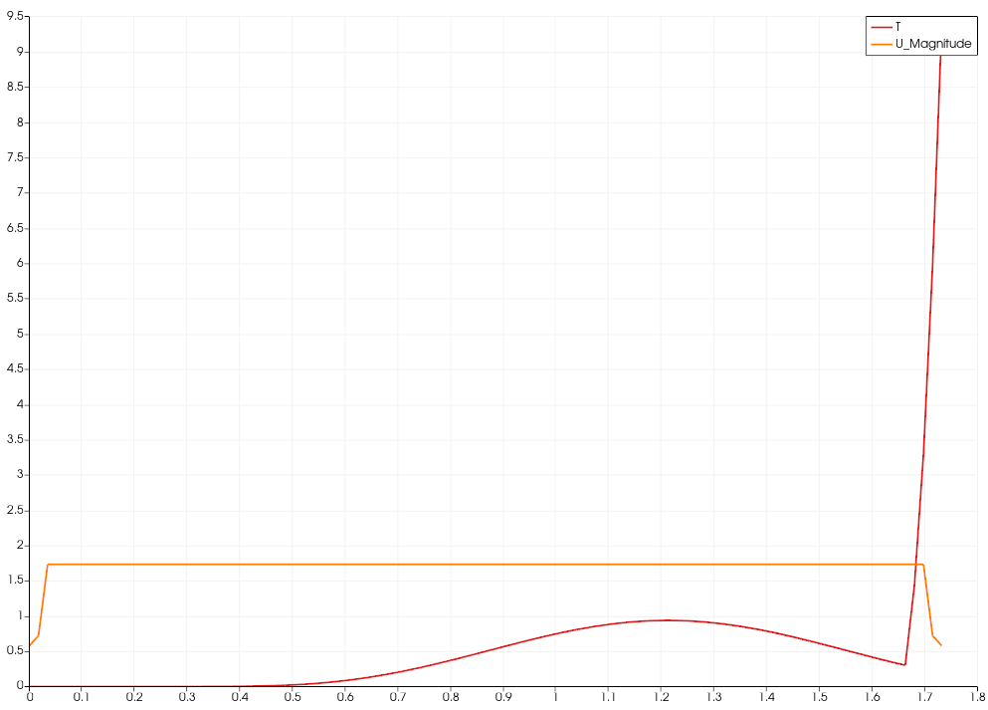
Results
Results in Paraview

Slide 24
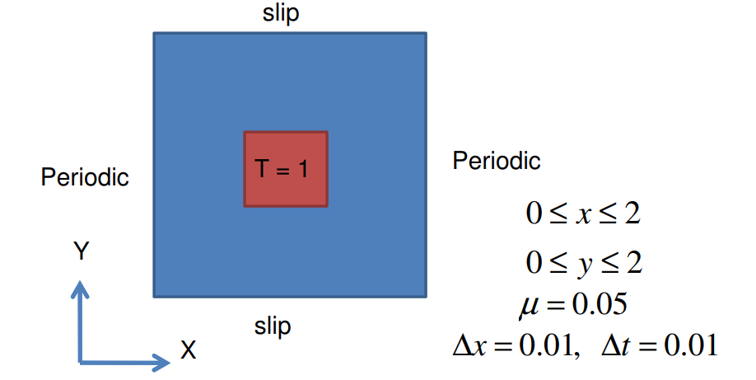
Running Simulation – Example 2

Slide 25
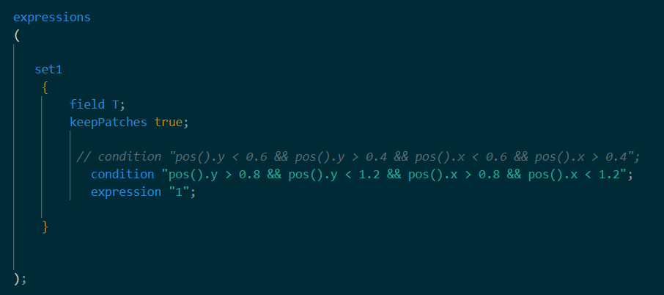
Running Simulation – Example 2
funkySetFieldsDict

Slide 26
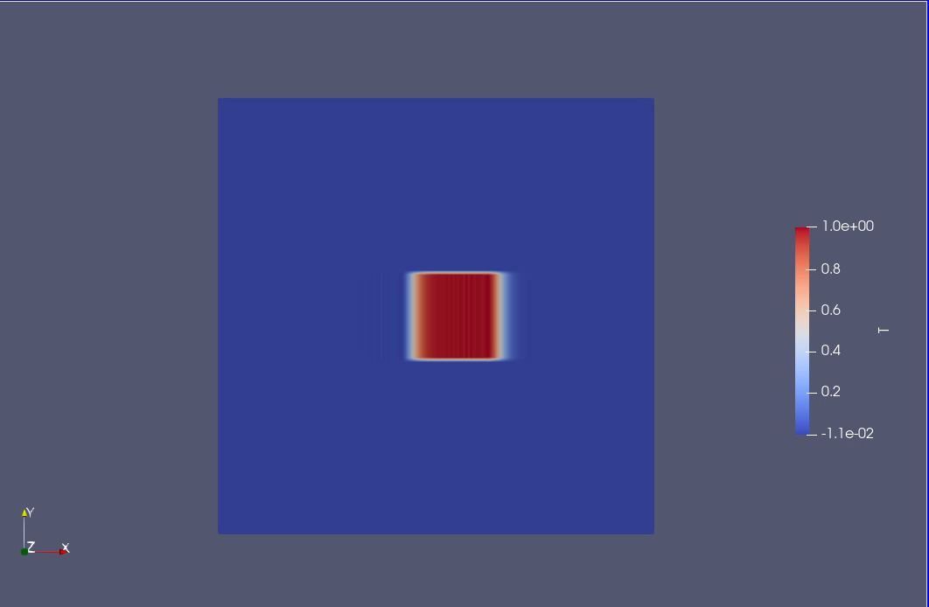
Running Simulation – Example 2

Slide 27
References
https://www.openfoam.com/documentation/user-guide
https://www.openfoam.com/documentation/overview
https://openfoam.org/search/programming+guide/

